Slide 1
Picturing Your Program: An Introduction To Logic Modeling
Yvonne Watson
U.S. Environmental Protection Agency

Slide 2

Agenda
Welcome & Introductions
Purpose of Today’s Session
Overview of Logic Models
Logic Modeling Exercise
Wrap Up
Notes:
 NOTES:

Slide 3
Why are we here?
Introduce you to the basics of logic models – what they are and how you can use them
Provide you with a stepwise approach for developing a logic model
Notes:
 NOTES:

Slide 4
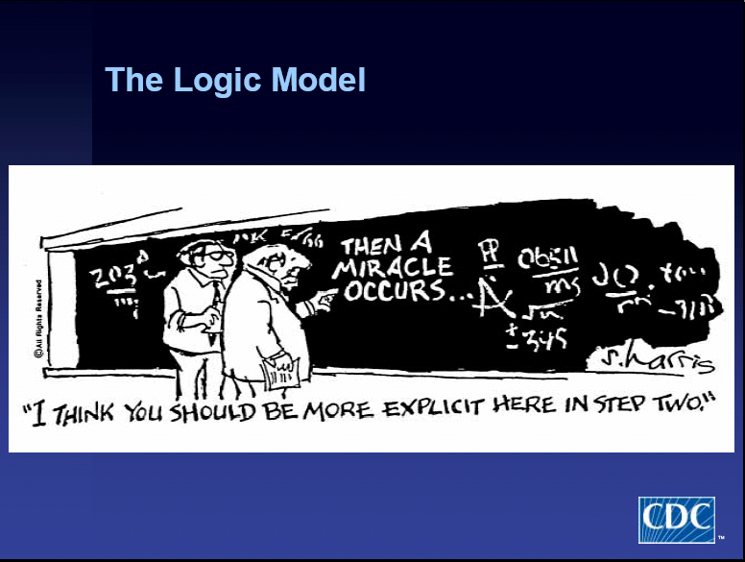
Notes:
NOTES:

Slide 5
What is a logic model?
A picture. Graphic and text that illustrates the relationship between a program’s activities and its intended outcomes and results.
To produce these outputs…
So that these customers can change their ways…
We use these resources…
For these activities…
Which leads to these outcomes…
Leading to these results!
Notes:
 NOTES:

Slide 6
What we have
The results
we see
Who we reach/ influence
HOW
WHY
What we do
What we produce/ deliver
Outcomes
Resources/ Inputs:
Programmatic investments available to support the program.
Activities
Things you do– activities you plan to conduct in your program.
Outputs
Product or service delivery/ implementation targets you aim to produce.
Customer
User of the products/ services. Target audience the program is designed to reach.
Short-term
Changes in learning, knowledge, attitude, skills, understanding
Attitudes
Inter-mediate
Changes in behavior, practice or decisions.
Behavior
Long-term
Change in condition.
Condition
RESULTS FROM PROGRAM
PROGRAM
External Influences
Factors outside of your control (positive or negative) that may influence the outcome and impact of your program/project.
Assumptions
The beliefs you have about the program, the people involved, the context and the way you think the program will work.
Notes:
6
 NOTES:

Slide 7
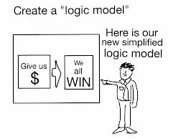
What are logic models used for?
Planning tool
Program design
Communication tool
Implementation tool
Measurement design
Evaluation design
Notes:
NOTES:

Slide 8
What are the benefits of logic models?
Illustrates the logic or theory of the program or project.
Focuses attention on the most important connections between actions and results.
Builds a common understanding among staff and with stakeholders.
Establish a framework for measurement and evaluation and informs program design.
Finds “gaps” in the logic of a program and works to resolve them.
Notes:
NOTES:

Slide 9
What are the limitations of logic models?
“Represents” reality; it is not reality
Linear nature fails to reflect/capture the complexity of some programs
Can over simplify a program
Causal attribution is questionable – does not prove the program caused the observed outcome
Does not reflect unintended outcomes (positive or negative)
Notes:
 NOTES:

Slide 10
When can logic models be used?
Work with grantees:
Ensure grantee compliance and accurate reporting of activities, outputs and outcomes
During planning to:
clarify program strategy
identify appropriate outcome targets (and avoid over-promising)
negotiate roles and responsibilities
During advocacy to:
justify why the program will work
explain how resource investments will be used
During staff and stakeholder orientation to:
explain how the overall program works
show how different people can work together
define what each person is expected to do
During implementation to:
provide an inventory of what you have and what you need to operate the program or initiative
make mid-course adjustments
Source: http://ctb.ku.edu/en/table-of-contents/overview/models-for-community-health-and-development/logic-model-development/main

Slide 11
How do you develop a logic model?
Step 1
Clarify program goal and brainstorm/define the elements of the program.
Step 2
Verify the logic table with stakeholders.
Step 3
Develop a diagram and text describing logical relationships.
Step 4
Verify the logic model with stakeholders.
Notes:
NOTES:

Slide 12

Case Study: Tools for Schools (TfS)
Launched in 1995 and managed by EPA Indoor Environments Division (IED) of the Office of Radiation and Indoor Air (ORIA).
Voluntary outreach program provides schools with an IAQ Tools for Schools Action Kit, which provides guidance to school personnel on adopting proactive IAQ management practices to improve indoor air quality.
Notes:
 NOTES:

Slide 13
Step 1. Clarify the program goal and brainstorm/define the program elements
Goal: Provide outreach, guidance & tools to assist school systems in reducing exposure to indoor contaminants by identifying, correcting and preventing indoor air quality (IAQ) problems (including asthma, allergy, and respiratory triggers) in the school environment.
Resources | Activities | Outputs | Customer reached | Short-term Outcome | Intermediate Outcome | Long-term Outcomes
19 EPA FTE (HQ & Regions) Annual Budget Grant funding EPA Contractor support | Provide education/ outreach Conduct program recruitment Develop & distribute IAQ management products Raise public IAQ awareness | Trainings, symposia, conferences, walkthroughs TfS products IAQ hotline reports Articles, trade press, media tracking reports | State & Local health officials State & local education officials School officials Teachers & students Facilities staff School nurses Unions Community groups Architects & facility planners General public | Increased awareness of IAQ & effective IAQ management practices from federal/state efforts Development of IAQ management plan, policies & communications plan from federal & state efforts | Implementation/ institutionalization of IAQ policies & practices from federal & state efforts | Decrease in asthma, allergy, & other IAQ symptoms
National Partners | Conduct research Management awards program | Publications, case studies Issue awards
State and Local Partners
External factors: Budget constraints, existing mandates, competing priorities, bond issues.
Notes:
 NOTES:

Slide 14
Step 2. Verify the logic table with stakeholders
Program Goal/Purpose: Provide outreach, guidance & tools to assist school systems in reducing exposure to indoor contaminants by identifying, correcting and preventing indoor air quality (IAQ) problems (including asthma, allergy, and respiratory triggers) in the school environment.
If…then
If…then
If…then
If…then
If…then
If…then
Customers:
School officials, teachers & students, facilities staff, school nurses
Short-term Outcome:
Increased awareness of IAQ & effective management practices
Intermediate Outcome: Development & implementation of IAQ plan, policies & practices
Long-term Outcome:
Decrease in IAQ Triggers
Decrease in Asthma
Outputs: Training, symposium, conferences, walkthroughs
Resources: 19 EPA FTE
(HQ & Regions)
Activities: Provide education/ outreach
Notes:
 NOTES:

Slide 15
Step 3. Develop a diagram and text describing logical relationships
Program Purpose: Provide outreach, guidance & tools to assist school systems in reducing exposure to indoor contaminants by identifying, correcting and preventing indoor air quality (IAQ) problems (including asthma, allergy, and respiratory triggers) in the school environment.
Customers:
School officials, teachers & students, facilities staff, school nurses
Short-term Outcome:
Increased awareness of IAQ & effective management practices
Intermediate Outcome: Development & implementation of IAQ plan, policies & practices
Long-term Outcome:
Decrease in IAQ Triggers
Decrease in Asthma
Activities: Provide education/ outreach
Outputs: Training, symposium, conferences, walkthroughs
Resources: 19 EPA FTE
(HQ & Regions)
Notes:
 NOTES:

Slide 16
Step 4. Verify the logic model with stakeholders
Key Questions to Consider…
Are the program’s outcomes described?
Are the program’s customers described?
Are the program’s major resources, activities and outputs described and do they make sense?
Are there things/issues that might influence the program’s ability to achieve its goal?
Notes:
 NOTES:

Slide 17
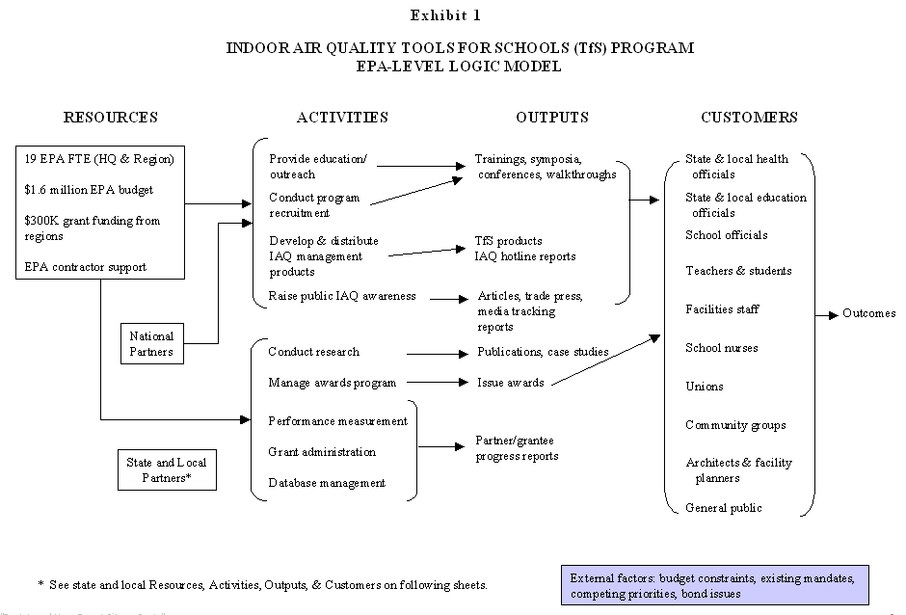
Notes:
 NOTES:

Slide 18
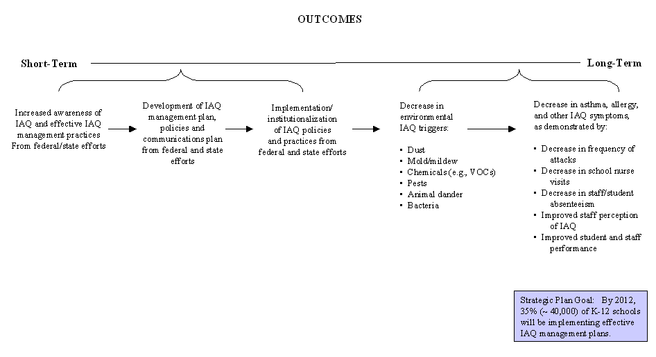
INDOOR AIR QUALITY TOOLS FOR SCHOOLS (TfS) PROGRAM
EPA -LEVEL LOGIC MODEL (CONTINUED)
Notes:
 NOTES:

Slide 19
Example Logic Models

Slide 20
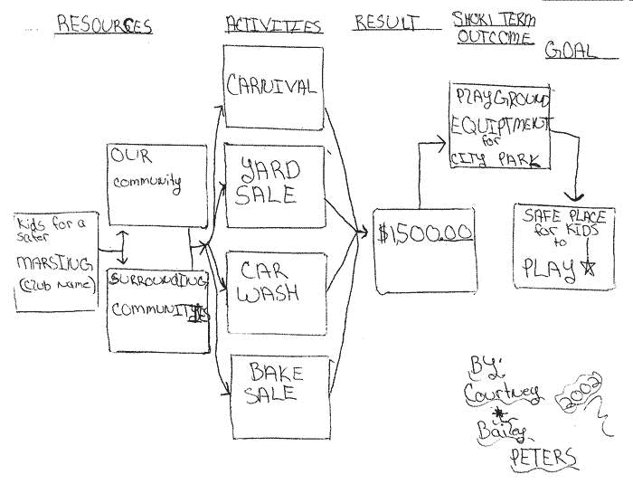
Courtney and Bailey Peter’s Model: A Safe Place to Play
Source: Community Tool Box: http://ctb.ku.edu/tools/sub_section_examples_1877.htm#example6
Notes:
 NOTES:

Slide 21
Lead A Great Life
Program Areas
Activities and processes
Short-term goals
(Impact Measures)
Long-term goals
(Outcome Measures)
VACUUM AT LEAST ONCE A MONTH
FIND A PLACE TO PUT MY JUNK
GO GROCERY SHOPPING WEEKLY
PLAN MEALS
MAINTAIN A FOOD DIARY
BY 2010 IMPROVED SELF-ESTEM (PSYCHOLOGICAL TEST)
DECREASED DISTRACTEDNESS (PSYCHOLOGICAL TEST)
REDUCED # OF ASTHMA ATTACKS FROM DUST MITES
PERSONAL
INCREASE # OF DAYS WHEN 5 FRUITS AND VEGETABLES ARE CONSUMED
Lead a great life
BRUSH AND FLOSS AFTER EVERY MEAL
USE OIL OF OLAY
SKIN TREATMENTS
IDENTIFY NEW WAYS TO MEET PEOPLE
INTER-PERSONAL
BY 2010, INCREASE BY 200% THE NUMBER OF DATES PER YEAR
BY 2013 HAVE BIRTH CERTIFICATES FOR TWO CHILDREN
TAKE GUITAR LESSONS AND PRACTICE DAILY
WRITE 2 NEW SONGS PER MONTH
FORM A BAND
HOBBIES
BY 2013, INCREASE BY 300% THE NUMBER OF FEATURED PERFORMANCES PER YEAR
BY 2025 BECOME A FAMOUS ROCK STAR (WIN A GRAMMY)

Slide 22
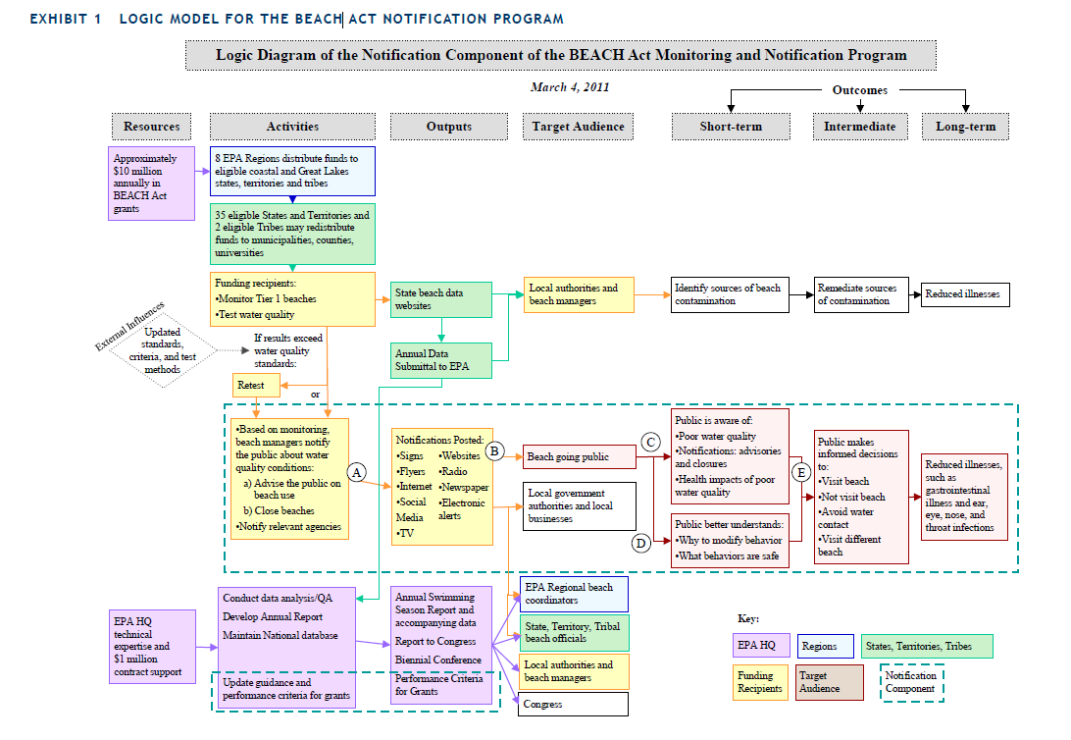

Slide 23
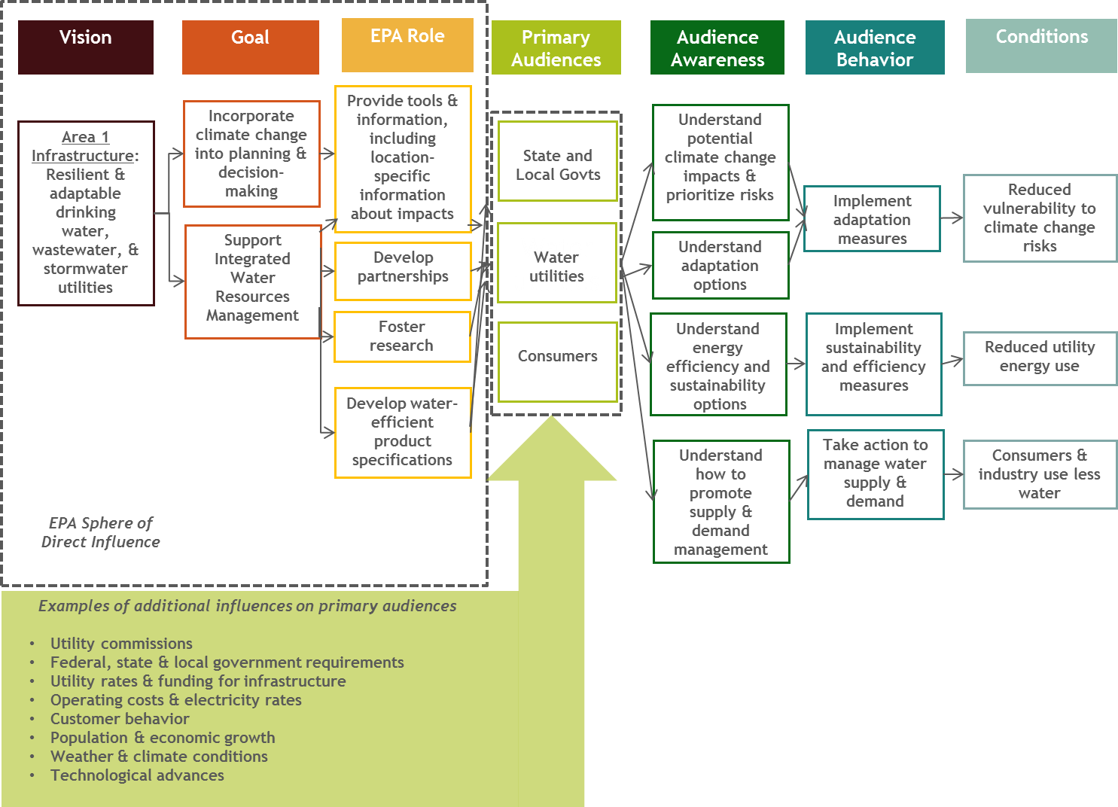
OW Area 1 Logic Model: Infrastructure
(Exhibit 2-2)
Source: Evaluation of National Water Program’s
Climate Change Adaptation Strategy, Final Report, July 22, 2013

Slide 24
Exercise
Think about someone or something you want to change (Self, State Agency, Batting average for little league team, etc. )
Why is this change important? To what outcome/results will it lead?
What aspect of the change do you have direct control over? What else has to happen to enable full realization of the change
Now, develop a logic model that will describe how you will achieve the desired change.

Slide 25
What next?
Questions
Wrap Up
Building on your logic model
Developing Performance Measures
Evaluation Questions

Slide 26

Contacts
Yvonne M. Watson
watson.yvonne@epa.gov
202.566.2239

Slide 27
Appendix

Slide 28
Performance Management Tools
Performance Management
Performance management includes activities to ensure that goals are consistently being met in an effective and efficient manner. Performance management tools include logic models, performance measurement and program evaluation.
Logic Model
Tool/framework that helps identify the program/project resources, activities, outputs customers, and outcomes.
Performance Measurement
Helps you understand what level of performance is achieved by the program/project.
Program Evaluation
Helps you understand and explain why you’re seeing the program/project results.
Notes:
NOTES:
.

Slide 29
Measures Across the Logic Model Spectrum
Element | Definition | Example of Measures
Resources/ Inputs | Measure of resources consumed by the organization. | Amount of funds, # of FTE, materials, equipment, supplies (etc.).
Activities | Measure of work performed that directly produces the core products and services. | # of training classes offered as designed; Hours of technical assistance training for staff.
Outputs | Measure of products and services provided as a direct result of program activities. | # of technical assistance requests responded to; # of compliance workbooks developed/delivered.
Customer Reached | Measure of target population receiving outputs. | % of target population trained; # of target population receiving technical assistance.
Customer Satisfaction | Measure of satisfaction with outputs. | % of customers dissatisfied with training; % of customers “very satisfied” with assistance received.
Outcomes | Accomplishment of program goals and objectives (short-term and intermediate outcomes, long-term outcomes--impacts). | % increase in industry’s understanding of regulatory recycling exclusion; # of sectors that adopt regulatory recycling exclusion; % increase in materials recycled.
Notes:
SCRIPT:

Slide 30
Work Quality Measures
Category | Definition | Examples
Efficiency | Measure that relates outputs to costs. | Cost per workbook produced; cost per inspection conducted.
Productivity | Measure of the rate of production per some specific unit of resource (e.g., staff or employee). The focus is on labor productivity. | Number of enforcement cases investigated per inspector.
Cost Effectiveness | Measure that relates outcomes to costs. | Cost per pounds of pollutants reduced; cost per mile of beach cleaned.
Service Quality | Measure of the quality of products and services produced. | Percent of technical assistance requests responded to within one week.
Notes:
 SCRIPT:

Slide 31
Evaluation and the Logic Model
Design Evaluation
HOW
WHY
Longer term
Resources/
Inputs
Activities
Outputs
Customers
Short term
Intermediate
outcome
outcome
outcome
(STRATEGIC
AIM)
Outcome
Evaluation
Impact
Evaluation
Process Evaluation
Source: Adapted from Evaluation Dialogue Between OMB and Federal Evaluation Leaders: Digging a Bit Deeper into Evaluation Science, April 2005
Notes:
SCRIPT:

Slide 32
Common Evaluation Questions
Evaluation Type | Common Evaluation Questions
Design Evaluation | Is the design of the program well formulated, feasible, and likely to achieve the intended goals?
Process/Implementation Evaluation | Is the program being delivered as intended to the targeted recipients? Is the program well managed? What progress has been made in implementing new provisions?
Outcome Evaluation | Are desired program outcomes obtained? What role, if any ,did the program play? What role, if any, did the context play? Did the program produce unintended outcomes?
Impact Evaluation | Did the program cause the desired impact? Is one approach more effective than another in obtaining the desired outcomes?
Source: Adapted from Evaluation Dialogue Between OMB and Federal Evaluation Leaders: Digging a Bit Deeper into Evaluation Science, April 2005
Notes:
SCRIPT:

Slide 33
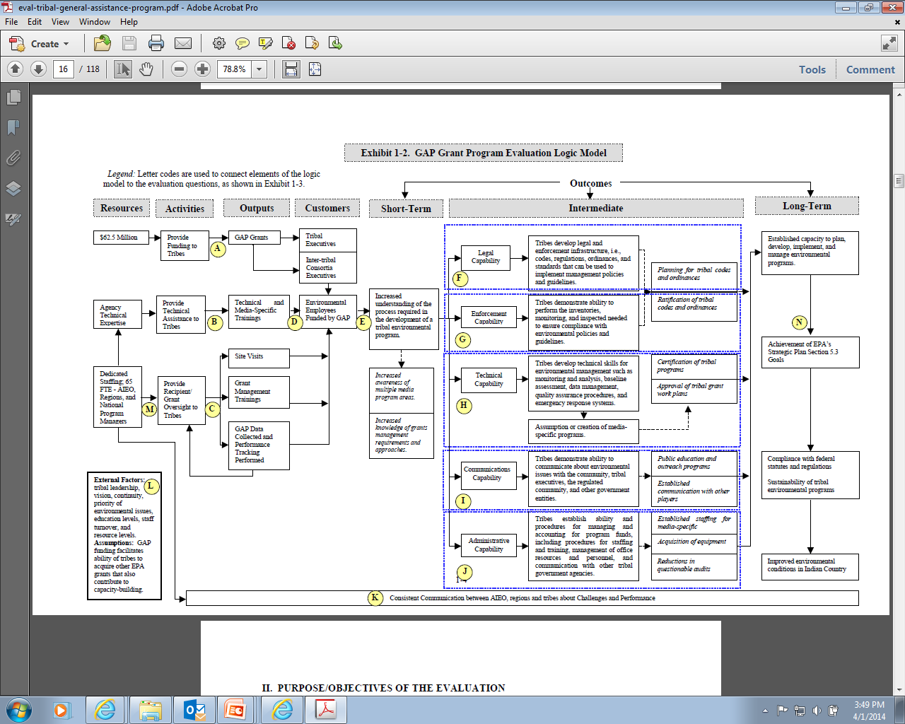

Slide 34
General Assistance Program (GAP) Grant Program Logic Model
Program Goal: The primary purpose of GAP is to help federally recognized tribes and intertribal consortia build the basic components of a tribal environmental program, which may include planning, developing, and establishing the administrative, technical, legal, enforcement, communication, and outreach infrastructure.
Outcomes
Resources
Activities
Outputs
Customers
Short-term
Intermediate
Long-term
$62.5 M
Provide Funding to Tribes
GAP Grants
Tribal Executives
Inter-Tribal Consortia Executives
Legal Capability
Tribes develop legal & enforcement infrastructure
Established capacity to plan, develop implement, & manage environmental programs
Enforcement Capability
Tribes demonstrate ability to perform monitoring & inspections to ensure compliance
Agency Technical expertise
Provide technical assistance to tribes
Technical & media- specific training
Tribal Environmental Employees funded by GAP
Increased understanding of the process required for an environ-mental program
Compliance with federal statues and regulations &
Sustainability of tribal environmental programs
Technical Capability
Tribes develop technical skills for environmental management
65 FTE
AIEO, Regions, National Program Mangers
Communications Capability
Tribes demonstrate ability to communicate about environmental issues
Improved environmental conditions in Indian Country
Administrative capability Tribes establish ability & procedures for managing & accounting for program funds, personnel, training etc.
Legend: Letter codes are used to connect elements of the logic model to the evaluation questions, as shown in Exhibit 1-3.
Notes:
 NOTES:

Slide 35
Tribal GAP Performance Measures
 | Resources | Activities | Outputs | Customer reached | Short-term Outcome | Intermediate Outcome | Long-term Outcomes
 | $62.5 M 65 FTE AIEO, Regions, National Program Managers | Provide funding to Tribes Provide technical assistance to Tribes | GAP Grants Technical & media-specific training | Tribal Executives Inter-Tribal Consortia Executives Tribal Environmental employees funded by GAP | Increased understanding of the process required for an environmental program | Legal capability Enforcement Capability Technical Capability Communications Capability Administrative Capability | Established capacity to plan, develop, implement & manage environmental programs Improved environmental conditions in Indian Country
 | Total GAP funding per year | Number and percent of Federally recognized Tribes that have received GAP funds between 1994 and 2004 | Percentage of tribes that have received technical assistance and media specific training | Total number of environmental employees supported with GAP funds Turnover rate for Tribal environmental employees | Self reported increase in knowledge and understanding about the necessary steps in developing a tribal environmental program Self-reported increase in skills needed to develop tribal environmental programs Self-reported change in awareness and commitment to environmental programs in tribes | # of GAP recipients that have developed tribal codes, standards or enforcement programs to control pollution
Logic Model Elements
Example Measures
Notes:
Picturing Your Program: Introduction to Logic Modeling
 NOTES:

Slide 36
General Assistance Program (GAP) Grant Program Logic Model
Program Goal: The primary purpose of GAP is to help federally recognized tribes and intertribal consortia build the basic components of a tribal environmental program, which may include planning, developing, and establishing the administrative, technical, legal, enforcement, communication, and outreach infrastructure.
Outcomes
Resources
Activities
Outputs
Customers
Short-term
Intermediate
Long-term
$62.5 M
Provide Funding to Tribes
GAP Grants
Tribal Executives
Inter-Tribal Consortia Executives
Legal Capability
Tribes develop legal & enforcement infrastructure
Established capacity to plan, develop implement, & manage environmental programs
A
What indicators of tribal capacity exist?
F
Is GAP being accessed by all federally recognized tribes?
Enforcement Capability
Tribes demonstrate ability to perform monitoring & inspections to ensure compliance
Agency Technical expertise
Provide technical assistance to tribes
Technical & media- specific training
Tribal Environmental Employees funded by GAP
Increased understanding of the process required for an environ-mental program
G
Compliance with federal statues and regulations &
Sustainability of tribal environmental programs
Technical Capability
Tribes develop technical skills for environmental management
E
65 FTE
AIEO, Regions, National Program Mangers
H
How does participation in GAP increase understanding of how to develop a tribal environmental program?
Communications Capability
Tribes demonstrate ability to communicate about environmental issues
I
Improved environmental conditions in Indian Country
To what extent have tribes achieved environmental capacity as suggested by the presence of indicators?
Administrative capability Tribes establish ability & procedures for managing & accounting for program funds, personnel, training etc.
Legend: Letter codes are used to connect elements of the logic model to the evaluation questions, as shown in Exhibit 1-3.
J
Notes:
 NOTES:

